Slide 1
Workshop on Data Science
DAY 3

Slide 2
Today’s agenda
Unsupervised learning Theory
k means clustering
Association rule
Dimensionality reduction
Bonus: Hands on exp of unsupervised learning concepts and Analysis of data

Slide 3
Unsupervised learning
Unsupervised learning is a type of machine learning technique where algorithms are able to learn from data without any kind of human supervision. This is unlike supervised learning, where the data is labelled and the algorithm learns by comparing its predictions to the labels.
In unsupervised learning, the data is unlabeled, meaning it doesn't have any predefined categories or classifications. The algorithms are tasked with finding hidden patterns or structures within this data on their own. This can be useful for a variety of tasks,

Slide 4
types
There are three main types of unsupervised learning:
Clustering
Association rule learning:
Dimensionality reduction:

Slide 5
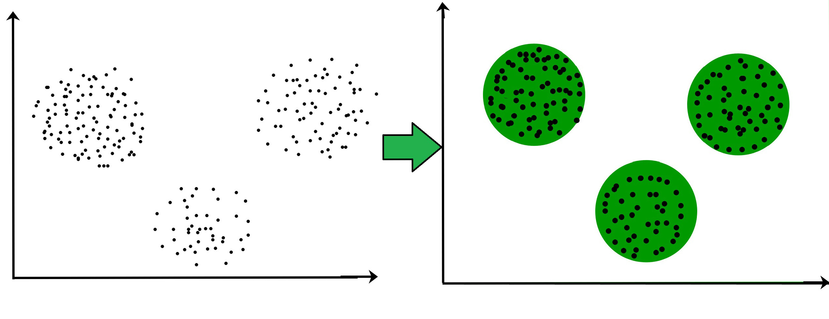
clustering
This type of unsupervised learning involves grouping data points together based on their similarities. Clustering algorithms work by iteratively moving data points closer to their cluster centers and further away from data points in other clusters.
A common example of a clustering algorithm is the K-means algorithm, which partitions data points into a user-defined number of clusters (k). There are many other clustering algorithms available, each with its own strengths and weaknesses.

Slide 6
Association rule
This type of unsupervised learning is used to discover relationships between different items in a dataset. Association rule learning algorithms are often used in market basket analysis, which is a technique used to identify patterns in customer purchase history.
For example, an association rule learning algorithm might discover that customers who buy diapers are also likely to buy baby wipes. This information can then be used to target marketing campaigns more effectively.

Slide 7
Dimensionality reduction
This type of unsupervised learning is used to reduce the number of features in a dataset. This can be useful for a variety of reasons, such as improving the performance of machine learning algorithms or making data easier to visualize.
There are many different dimensionality reduction techniques available, including principal component analysis (PCA) and linear discriminant analysis (LDA).

Slide 8
K-means clustering
Unsupervised Learning

Slide 9
K-means
Clustering is nothing but grouping similar things together those similar things could be customer, product, websites anything which has certain features and attributes.
K-means is nothing but a most popular and also very very simple clustering algorithm, so in k-means
k is the no of clusters,
So first we have to tell the k value or we have to tell how many cluster we need
So k is the typically hyperparameter
Effectively k-means groups every points into k clusters and for every cluster it assigns something call centroids which is central point like c1,c2,c3.

Slide 10
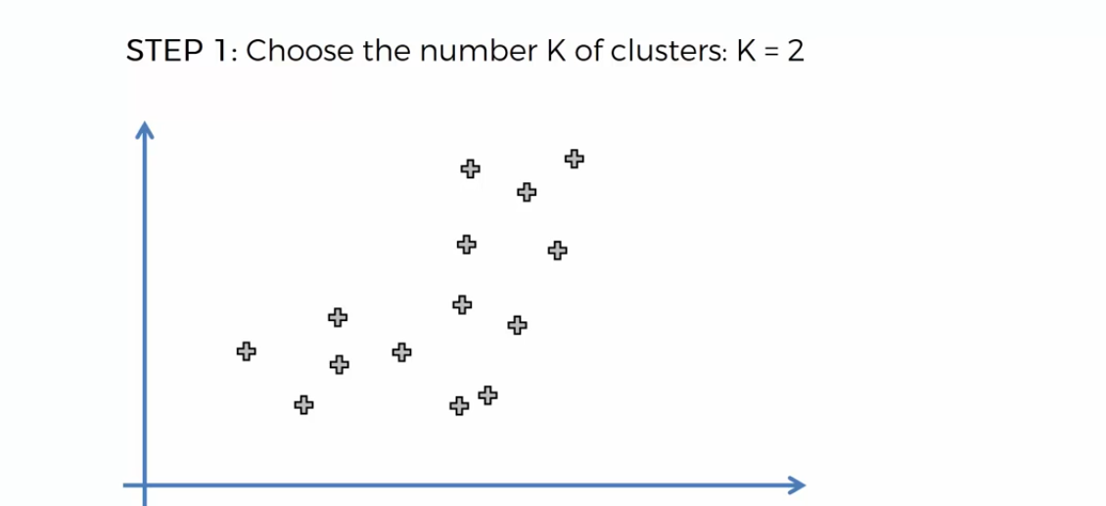
Steps involved in k-means

Slide 11
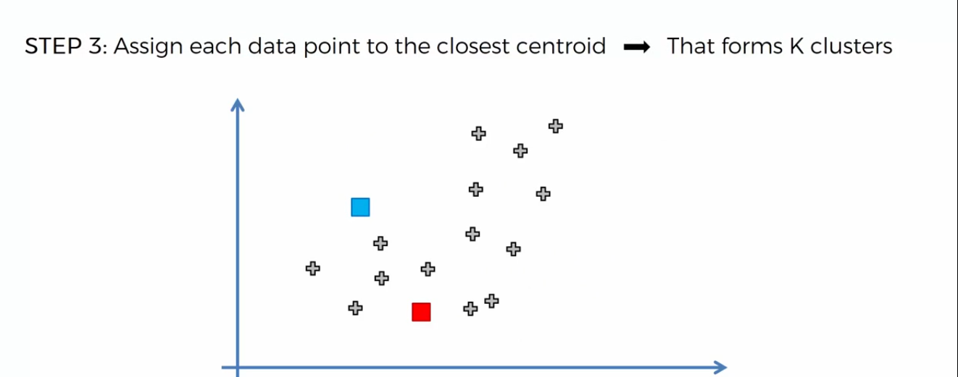
Steps involved in k-means

Slide 12
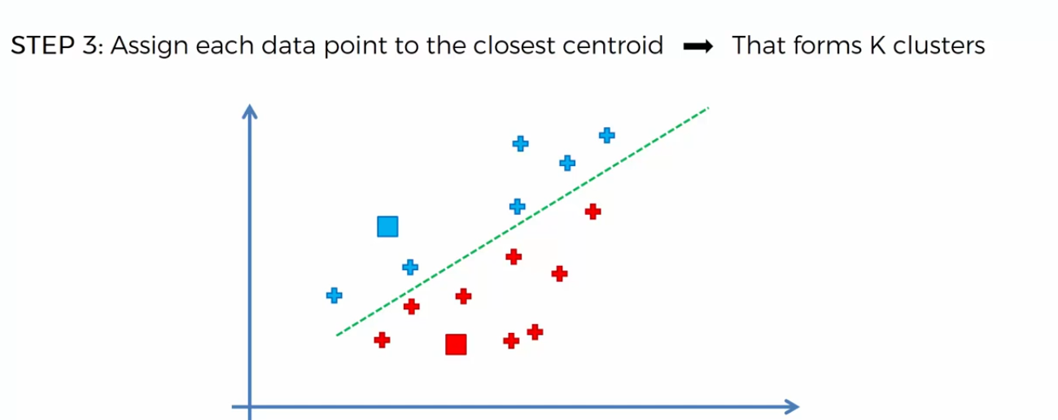
Steps involved in k-means

Slide 13
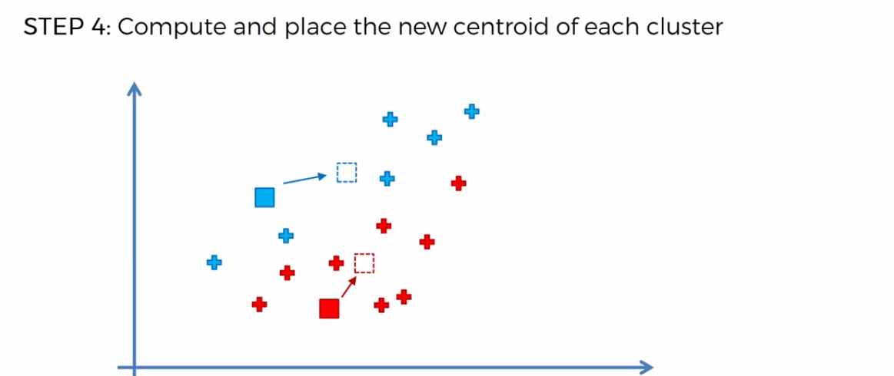
Steps involved in k-means

Slide 14
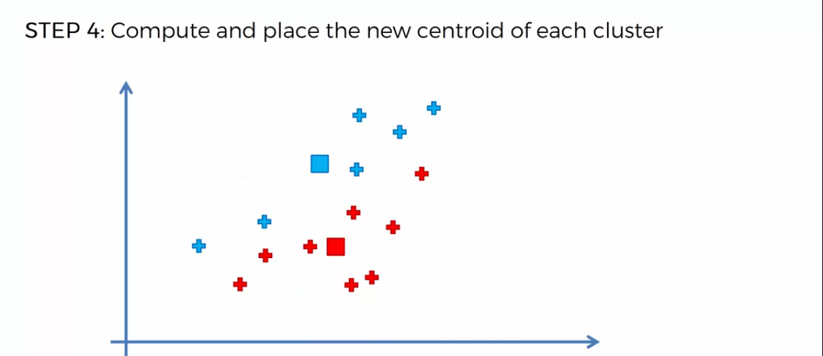
Steps involved in k-means

Slide 15
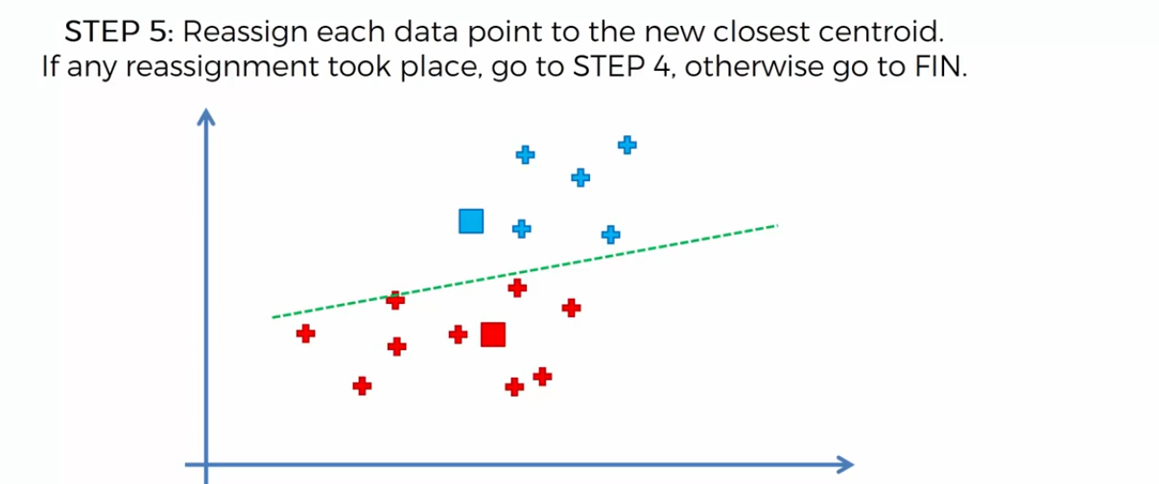
Steps involved in k-means

Slide 16
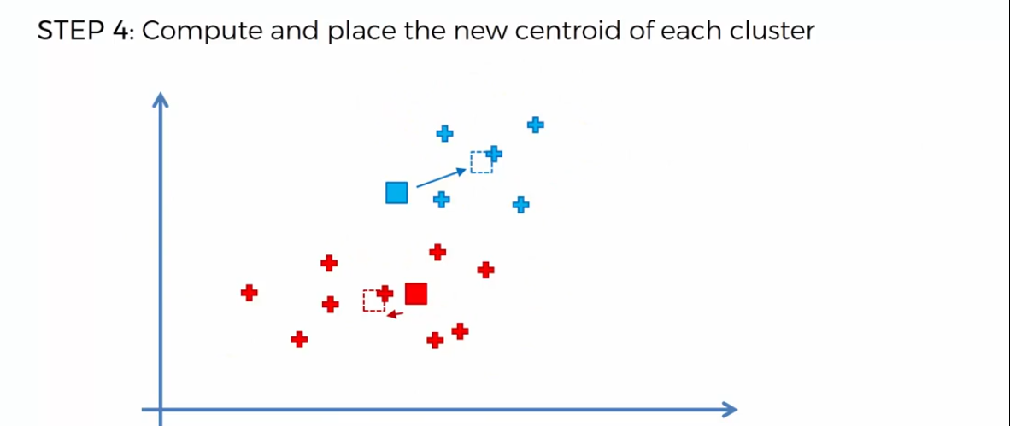
Steps involved in k-means

Slide 17
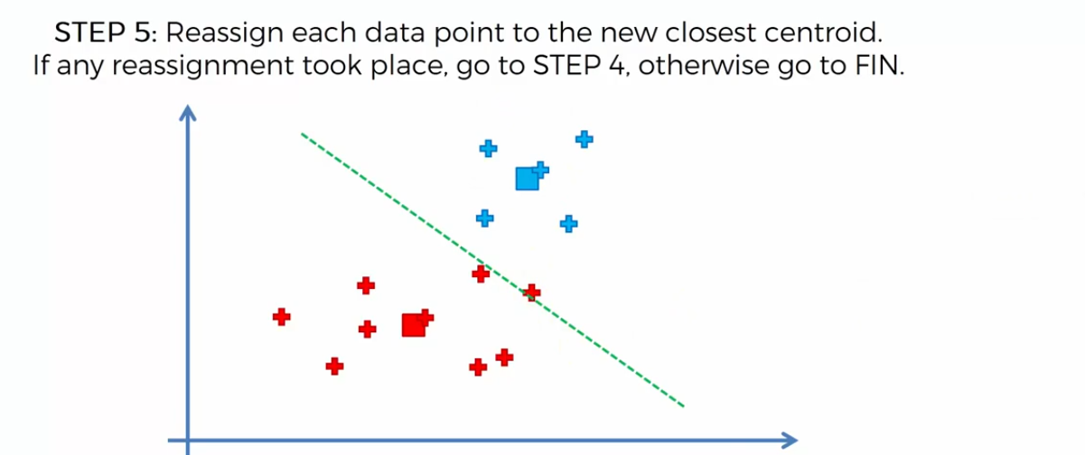
Steps involved in k-means

Slide 18
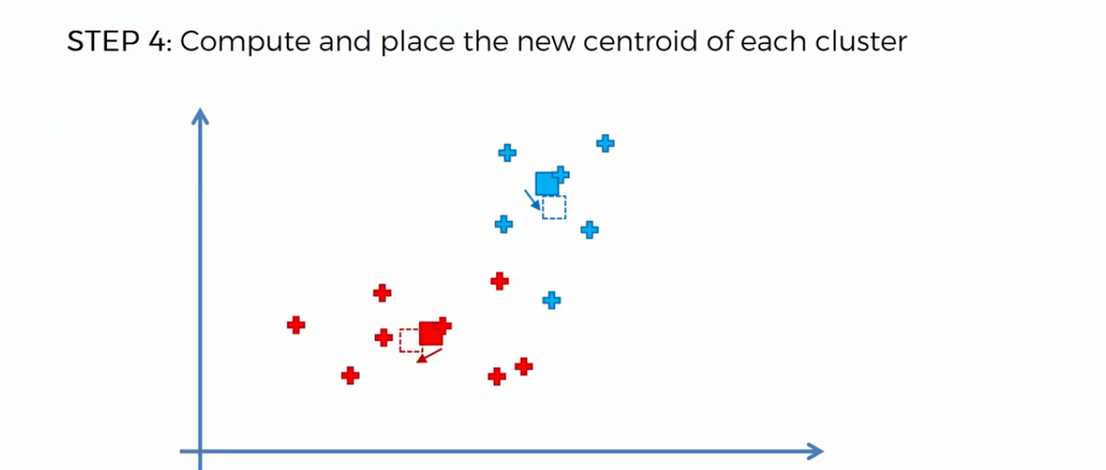
Steps involved in k-means

Slide 19
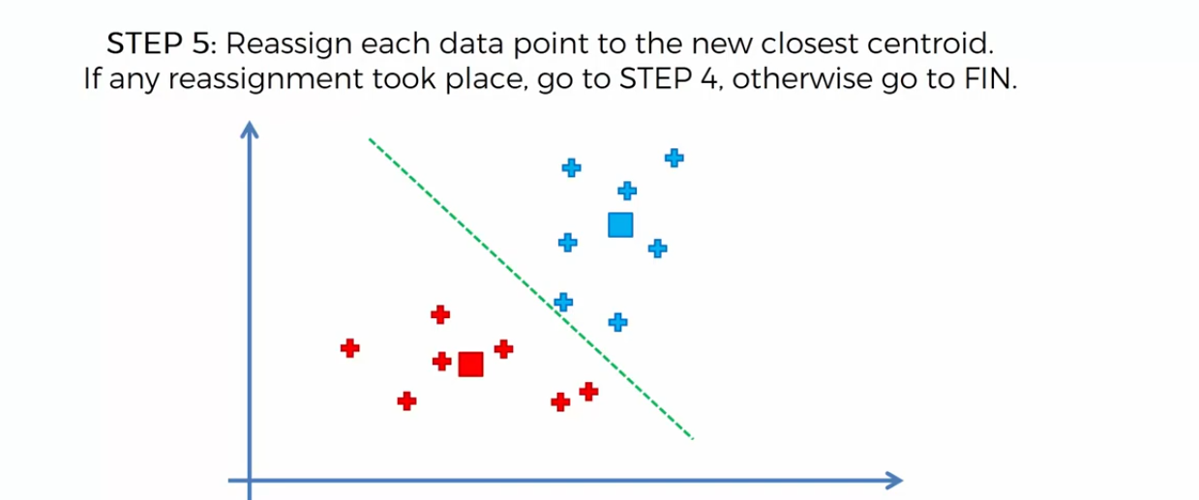
Steps involved in k-means

Slide 20
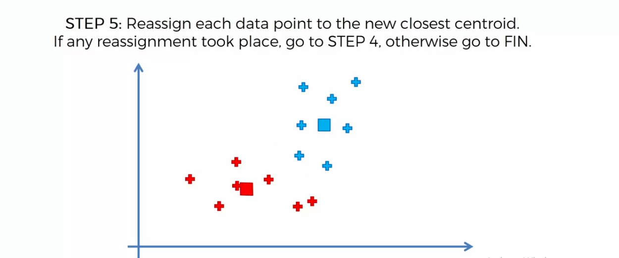
Steps involved in k-means

Slide 21
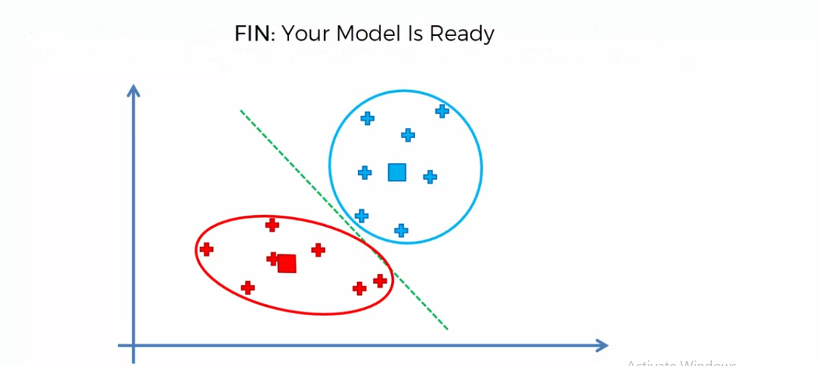
Steps involved in k-means

Slide 22
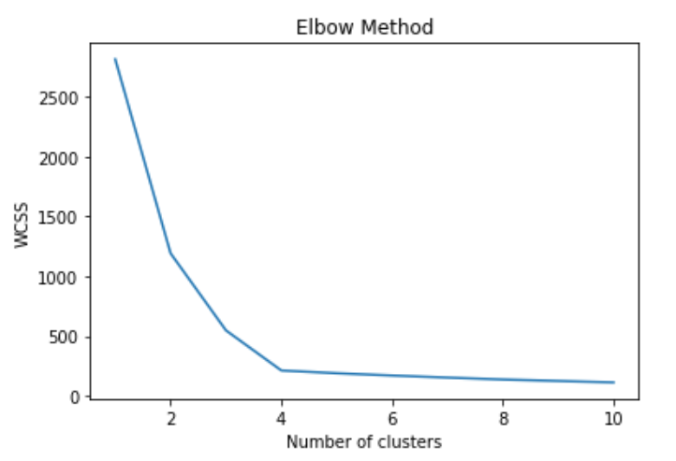
Elbow method

Slide 23
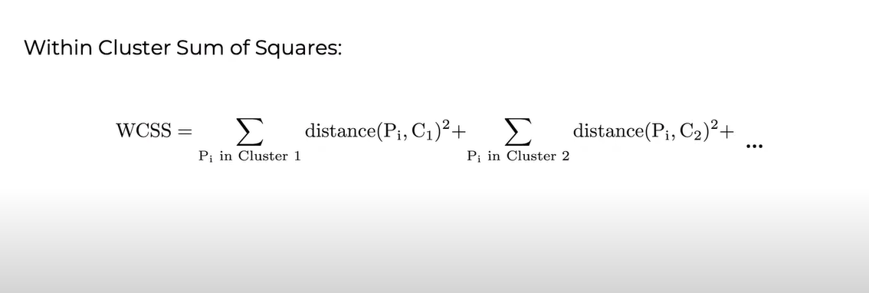
Elbow method

Slide 24
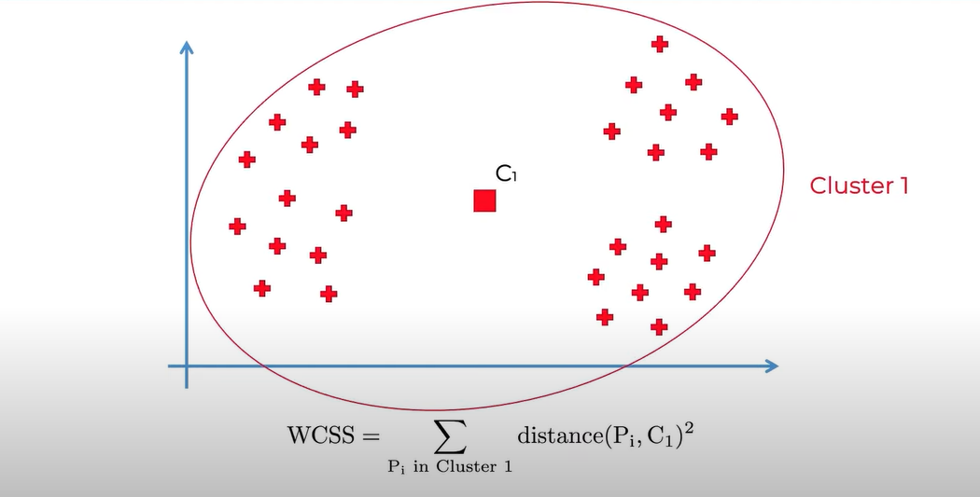
Elbow method

Slide 25
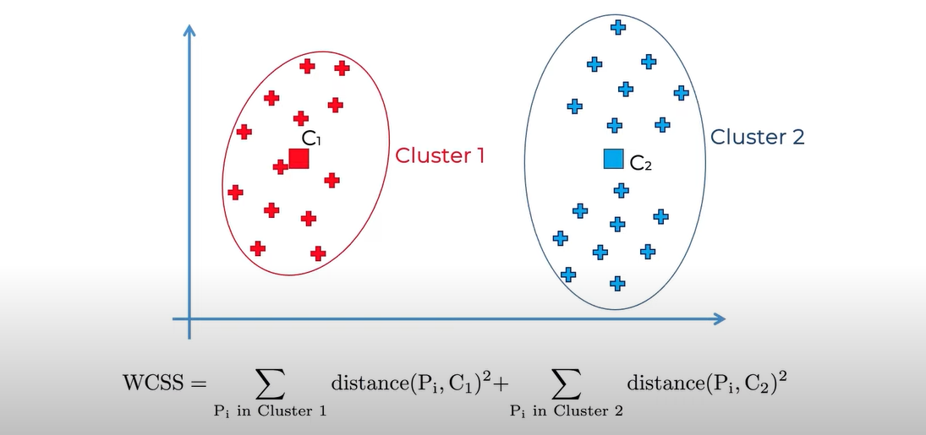
Elbow method

Slide 26
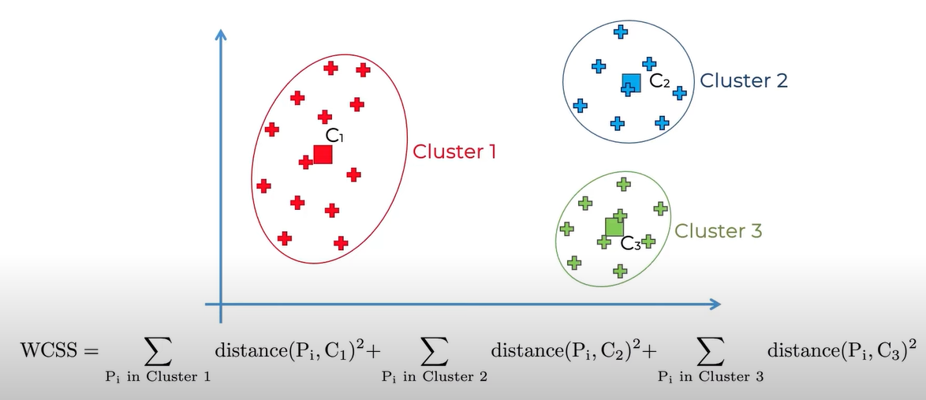
Elbow method

Slide 27
disadvantages
So k-means has the problem call initialization sensitivity means your final cluster and centroids depends on how you pick your random point in initialization stage which means your final result is sensitive or it is dependent on how you initialize this is the problem k-means has.
K-means has problems when clusters are of
Different
Sizes
Densities
Non-globular shapes
K-means has problems when the data
contains outliers.

Slide 28
Association Rule Learning
Apriori

Slide 29
Association Rule Learning
Association Rule Learning is a rule-based machine learning method for discovering interesting relationship between variables in large database.
It is intended to identity strong rules discovered in database using some measures of interestingness.
For example, the rule {onions, potatoes } { burger} found in the sale data of a supermarket would indicate that is a customer buys onions and potatoes together, they are likely to also buy burger.
Many algorithms for generating association rules have been proposed. Some well known algorithms are Apriori, Eclat and FP- Growth.

Slide 30
Apriori
Apriori algorithm is given by R. Agrawal and R. Srikant in 1994 for finding frequent itemsets in a dataset for boolean association rule.
Name of the algorithm is Apriori because it uses prior knowledge of frequent itemset properties.
Apriori algorithm uses frequent itemsets to generate association rules. It is based on the concept that a subset of a frequent itemset must also be frequent itemset.

Slide 31
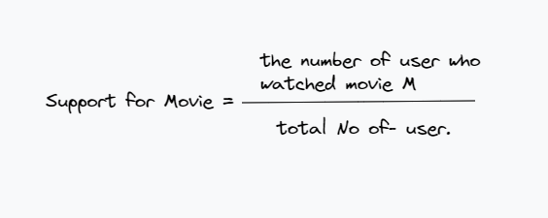
Apriori contd.
How apriori algorithms works?
Apriori algorithm has three parts Support, Confidence and Lift.
Support:

Slide 32
Apriori contd.
Let's consider an example we have 100 People, Let's say there's 10 People who have seen ex-machina out of 100 so our Support ,10/100 = 10%

Slide 33
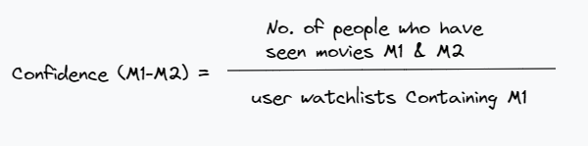
Apriori contd.
We need to find the confidence,

Slide 34
Apriori contd.
Let's consider same example, we have 100 People, 40 People out 100 have seen intersteller, and 7 people out of 40 have seen ex-machina. Means 7 people out of 40 People who have seen movies intersteller and ex-machina only 7 people who have seen both movie, so our Confidence is
Confidence 7/40 = 17.5%

Slide 35
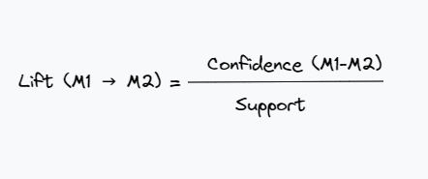
Apriori contd.
And last step is the Lift.
Lift = 17.5 / 10 = 1.75

Slide 36
Apriori contd.
Step 1: set a minimum support and confidence.
Step 2: Take all the subset in transaction having higher support than minimum support.
Step 3: Take all the rules of these subsets having higher confidence the minimum confidence.
Step 4: Sort the rules by decreasing lift.

Slide 37
Apriori contd.
Another Example:
result: {‘light cream', ‘chicken’}
Support: 0.00578…
Confidence: 0.29850.
lift: 4.84
Means people who bought light cream also bought chicken.
Support 0.005 means 0.5% of the transactions contain light cream and chicken together.
Confidence 0.29 means there is 29% chance people who bought light cream also bought chicken.
Lift 4.84 means (in our dataset we set minimum lift as 3) this rule is relevant. High value of the lift is goodness of rules.

Slide 38
Dimensionality Reduction
Dimensionality reduction is a fundamental technique in machine learning used to decrease the number of features (dimensions) in a dataset. This is done while aiming to retain the most important information to improve the performance of machine learning algorithms. There are several reasons why dimensionality reduction is important:
Reduces model complexity: With fewer features, machine learning models become simpler and require less computational resources to train. This can be especially beneficial for large datasets and complex models.
Improves algorithm performance: In some cases, high dimensionality can lead to a phenomenon called the "curse of dimensionality", where algorithms struggle to learn effectively due to the vastness of the feature space. Dimensionality reduction helps alleviate this issue.
Enables data visualization: When you have too many features, visualizing the data becomes difficult. By reducing dimensionality, you can project the data onto a lower-dimensional space (often 2D or 3D) for easier visualization and analysis.

Slide 39
Principal Component Analysis (PCA)
Principal Component Analysis (PCA): This is a popular unsupervised technique that identifies the most significant features (principal components) that capture the maximum variance in the data. PCA essentially creates new features, which are linear combinations of the original features.

Slide 40
Thank you

